Slide 1
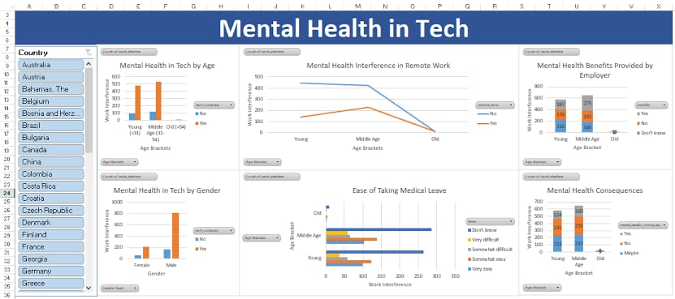
MENTAL HEALTH IN TECH SURVEY
Anonymous Peer Support Platform:
Create a platform where tech professionals can anonymously connect with peers facing similar mental health challenges, fostering a supportive community.

Slide 2
Mindfulness and Meditation Apps:
Integrate brief mindfulness and meditation exercises within the tech environment through apps, promoting mental well-being during work hours.
Flexible Work Hours:
Implement flexible work hours or remote work options to reduce stress and accommodate different personal schedules, contributing to a healthier work-life balance.

Slide 3
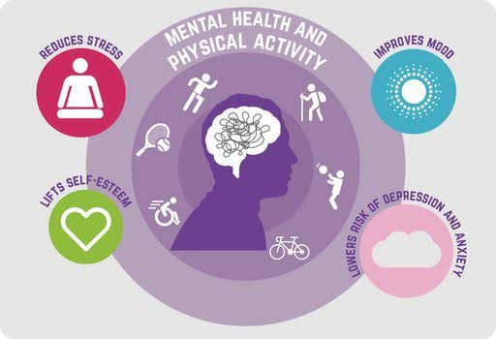
Virtual Mental Health Workshops:
Host virtual workshops on stress management, mindfulness, and resilience, providing tech employees with tools to cope with the unique challenges of the industry.

Slide 4

Regular Mental Health Check-ins :
Conduct regular, anonymous mental health check-ins to gauge the well-being of tech professionals and identify areas where additional support may be needed.
Educational Campaigns :
Launch campaigns that raise awareness about mental health in the tech industry, helping to destigmatize seeking help and fostering a culture of openness.

Slide 5

Mental Health Training for Managers :
Provide training to managers on recognizing signs of mental health issues, fostering a supportive work environment, and effectively addressing mental health concerns within their teams.
Employee Assistance Programs (EAP):
Offer comprehensive EAPs that include counseling services, workshops, and resources to support mental health needs in a confidential manner.

Slide 6
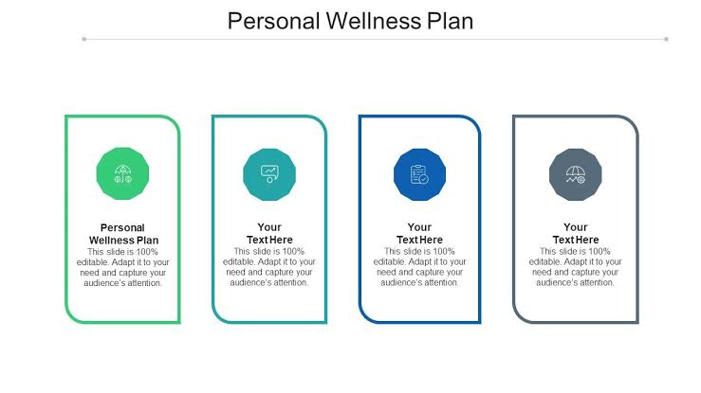
Personalized Wellness Plans:
Develop personalized mental health and wellness plans for employees, considering individual preferences and needs, and providing resources accordingly.
DATA SECURITY AND USER PRIVACY SHOULD BE PRIORITIZED BEFORE IMPLEMENTING THESE ABOVE IDEAS

